Slide 1
AC Circuits
Series and Parallel AC Circuits
By Dr. Ahmed S. Abdullah
د. احمد سليمان عبدالله

Slide 2
SERIES AC CIRCUITS
SERIES CONFIGURATION

Slide 3
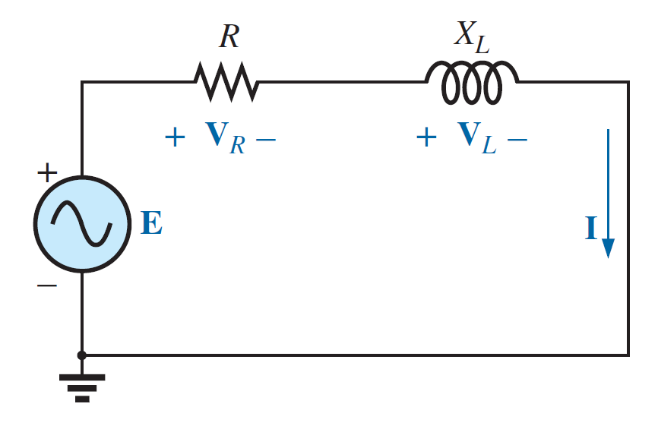
SERIES AC CIRCUITS
R-L

Slide 4
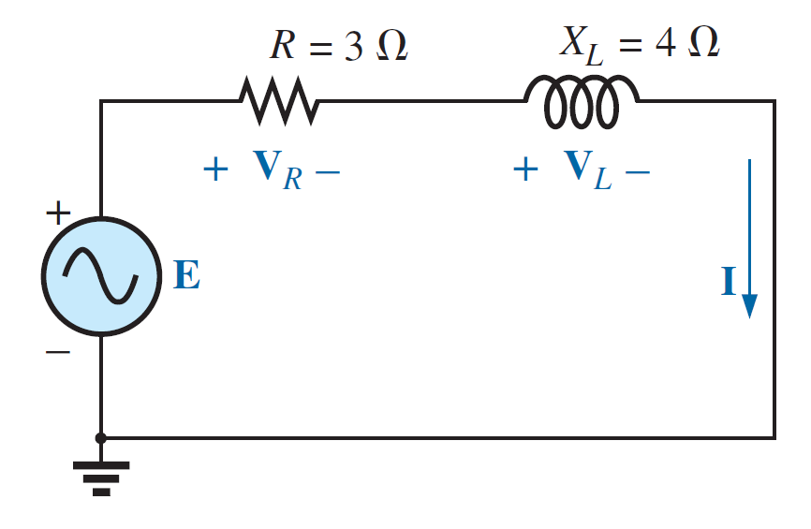
SERIES AC CIRCUITS
R-L

Slide 5
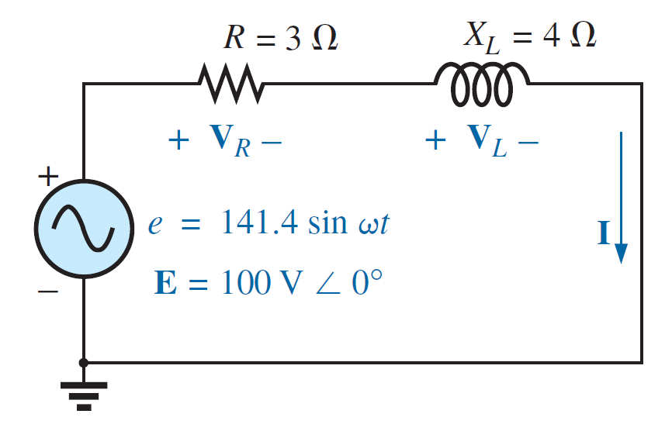
SERIES AC CIRCUITS
R-L

Slide 6
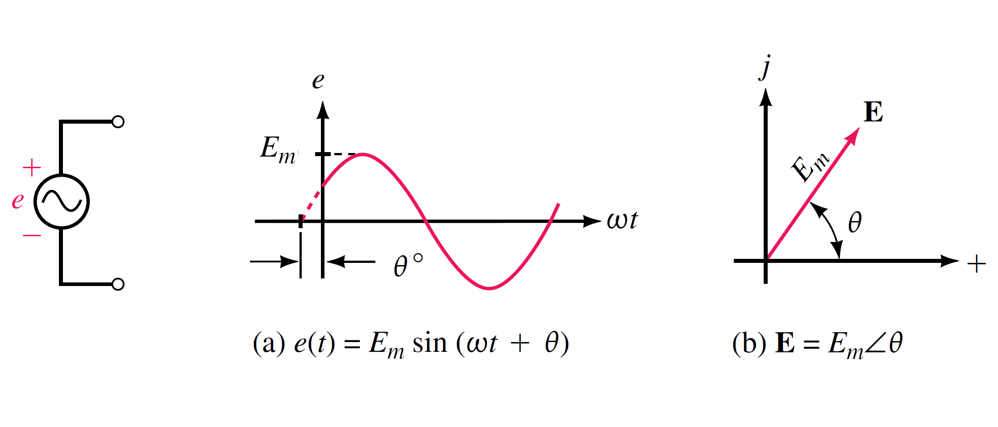
SERIES AC CIRCUITS
Transforming between time domain and phasor domain

Slide 7
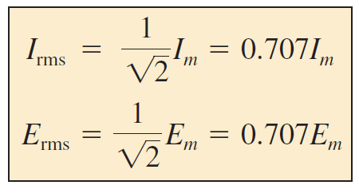
SERIES AC CIRCUITS
Transforming between time domain and phasor domain
The phasor will be redefined for the purposes of practicality and uniformity as having a magnitude equal to the RMS value of the sine wave it represents.
In general, for all of the analyses to follow, the phasor form of a sinusoidal voltage or current will be V and I
where V and I are RMS values and $θ$ is the phase angle.

Slide 8
SERIES AC CIRCUITS
Transforming between time domain and phasor domain

Slide 9
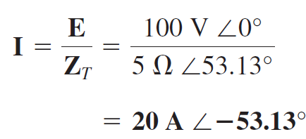
SERIES AC CIRCUITS
R-L

Slide 10
SERIES AC CIRCUITS
R-L

Slide 11
SERIES AC CIRCUITS
R-L

Slide 12
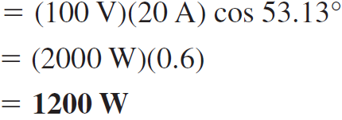
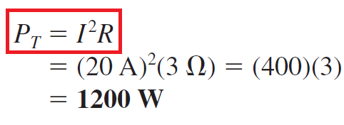
SERIES AC CIRCUITS
Power:
R-L
The total power in watts delivered to the circuit is

Slide 13
SERIES AC CIRCUITS
Power:
R-L
The total power in watts delivered to the circuit is

Slide 14
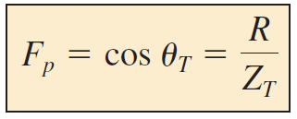
SERIES AC CIRCUITS
Power Factor:
R-L
Or

Slide 15
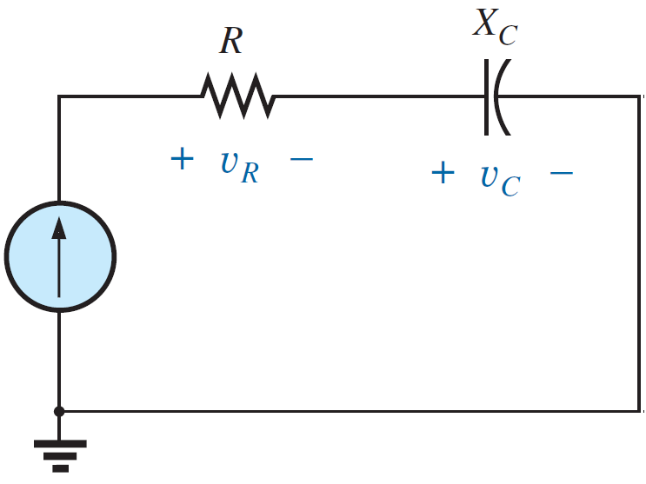
SERIES AC CIRCUITS
R-C

Slide 16
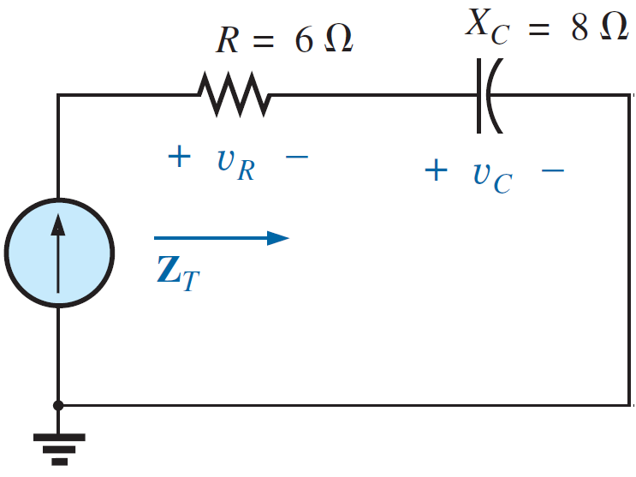
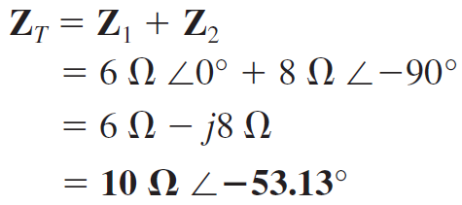
SERIES AC CIRCUITS
R-C

Slide 17
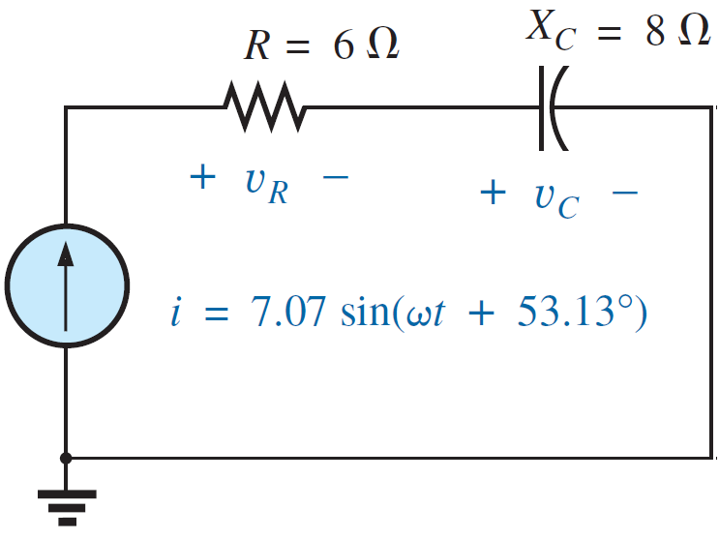
SERIES AC CIRCUITS
R-C

Slide 18
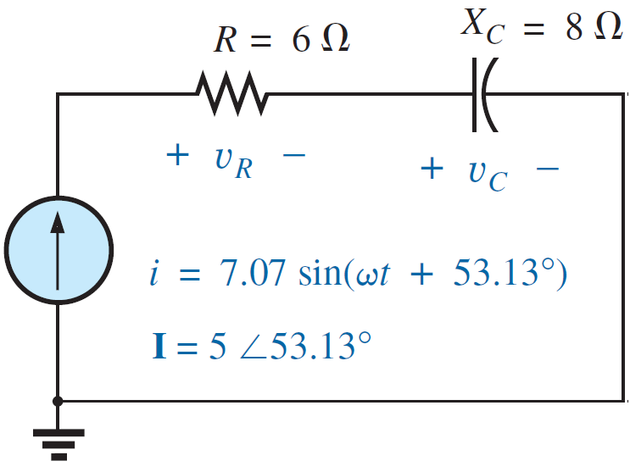
SERIES AC CIRCUITS
R-C

Slide 19
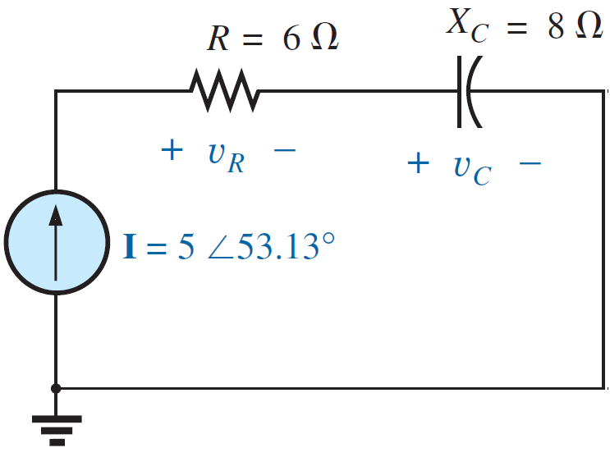
SERIES AC CIRCUITS
R-C

Slide 20
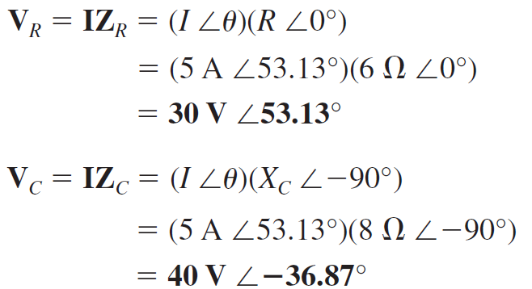
SERIES AC CIRCUITS
R-C

Slide 21
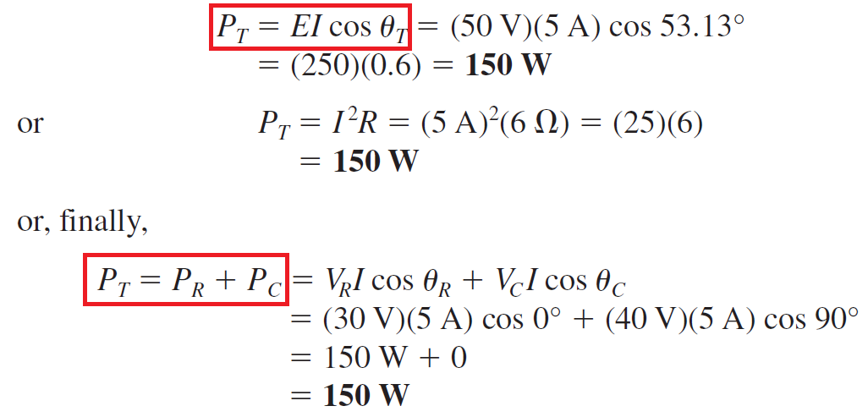
SERIES AC CIRCUITS
Power:
R-C
The total power in watts delivered to the circuit is

Slide 22
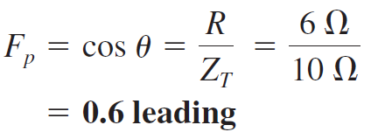
SERIES AC CIRCUITS
Power Factor:
R-C
Or

Slide 23
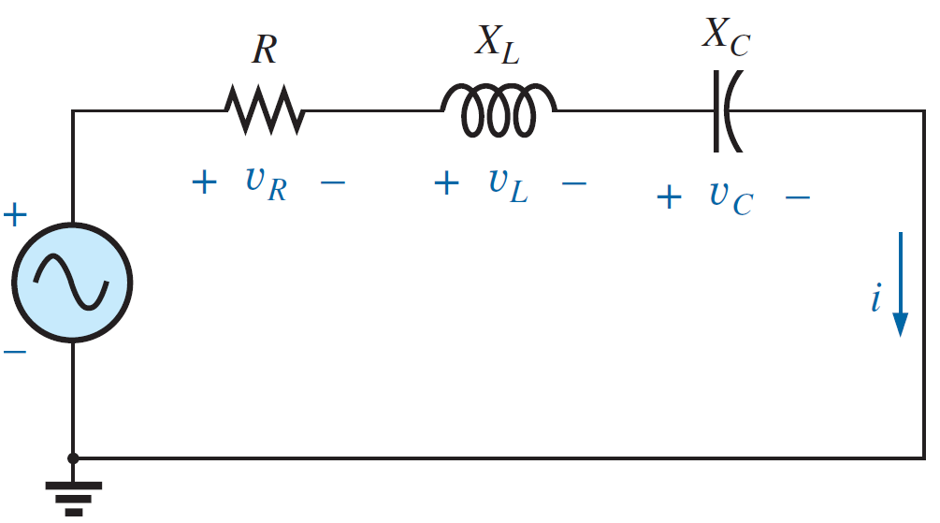
SERIES AC CIRCUITS
R-L-C

Slide 24
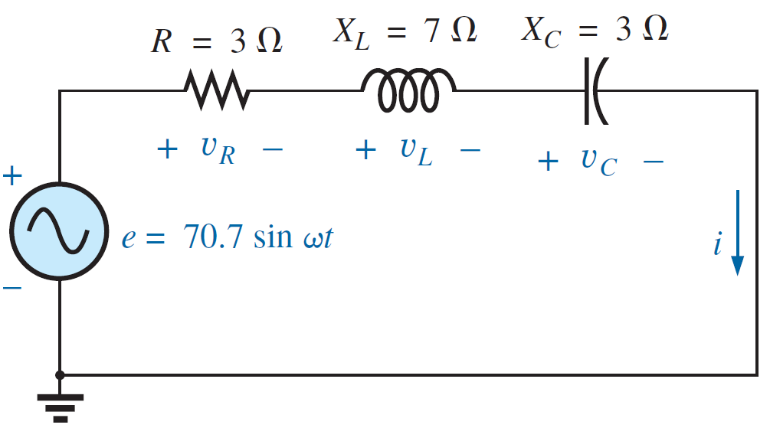
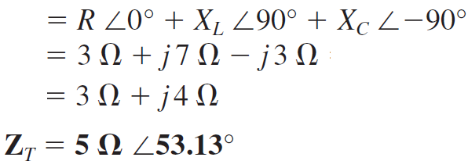
SERIES AC CIRCUITS
R-L-C

Slide 25
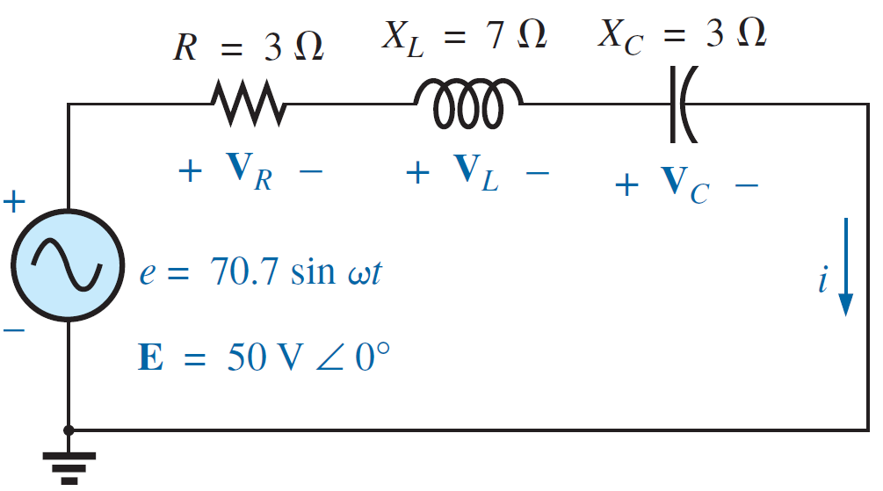
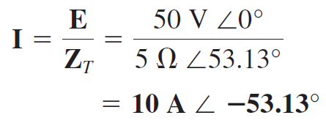
SERIES AC CIRCUITS
R-L-C

Slide 26
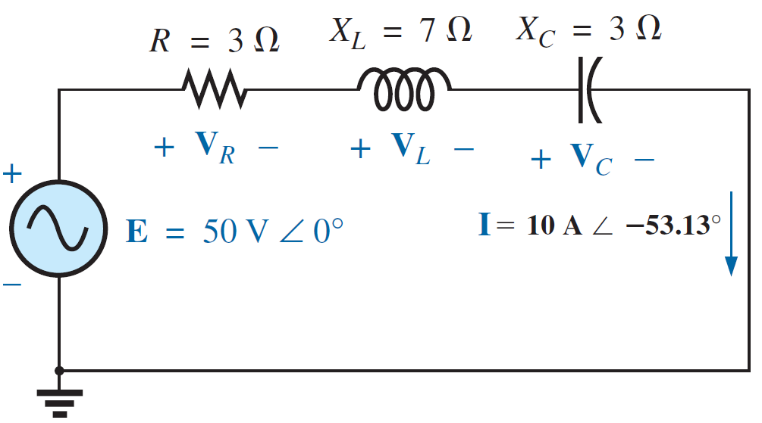
SERIES AC CIRCUITS
R-L-C

Slide 27
SERIES AC CIRCUITS
R-L-C

Slide 28
SERIES AC CIRCUITS
R-L-C

Slide 29
SERIES AC CIRCUITS
R-L-C

Slide 30
SERIES AC CIRCUITS
R-L-C

Slide 31
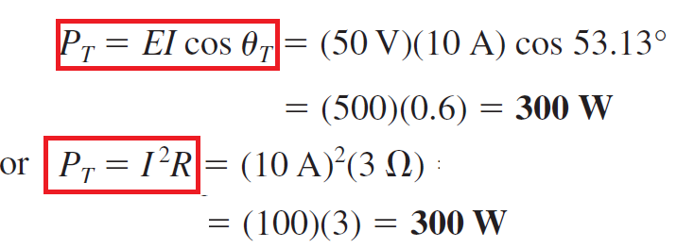
SERIES AC CIRCUITS
Power:
R-L-C
The total power in watts delivered to the circuit is

Slide 32
SERIES AC CIRCUITS
Power Factor:
R-L-C
Or

Slide 33
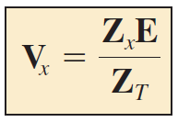
SERIES AC CIRCUITS
VOLTAGE DIVIDER RULE
The basic format for the voltage divider rule in AC circuits is exactly the same as that for DC circuits:
where V_{x} is the voltage across one or more elements in a series that have total impedance Z_{x} , E is the total voltage appearing across the series circuit, and Z_{T} is the total impedance of the series circuit.

Slide 34
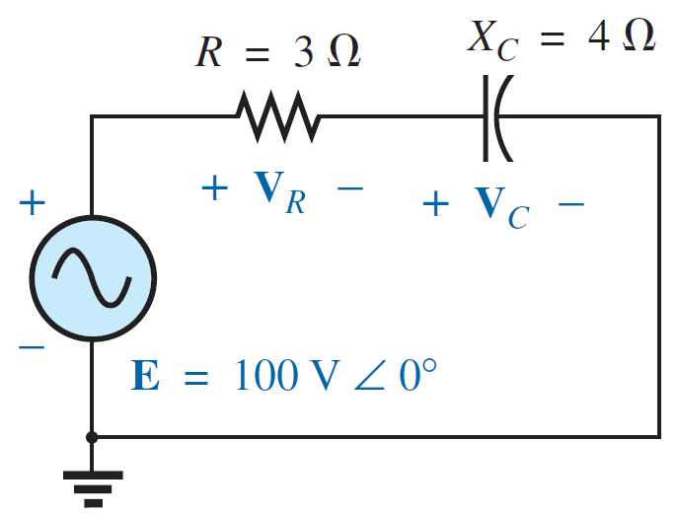
SERIES AC CIRCUITS
VOLTAGE DIVIDER RULE
EXAMPLE 1: Using the voltage divider rule, find the voltage across each element of the circuit in Figure shown.

Slide 35
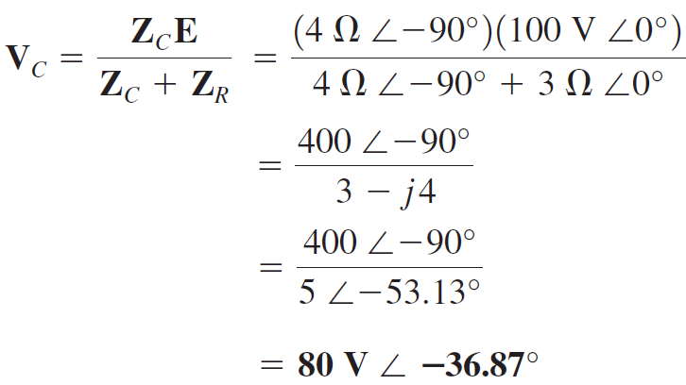
SERIES AC CIRCUITS
VOLTAGE DIVIDER RULE
EXAMPLE 1: Using the voltage divider rule, find the voltage across each element of the circuit in Figure shown.
Solution:

Slide 36
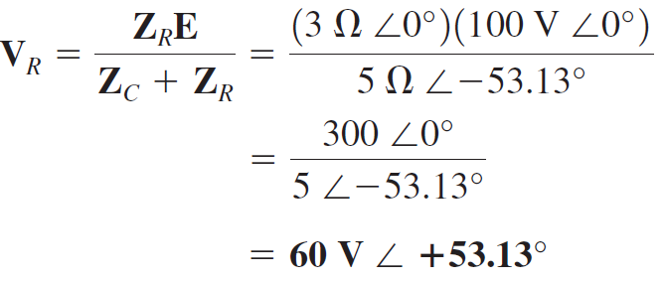
SERIES AC CIRCUITS
VOLTAGE DIVIDER RULE
EXAMPLE 1: Using the voltage divider rule, find the voltage across each element of the circuit in Figure shown.
Solution:

Slide 37
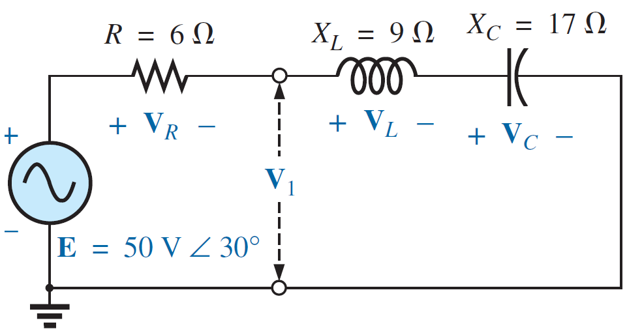
SERIES AC CIRCUITS
VOLTAGE DIVIDER RULE
EXAMPLE 2: Using the voltage divider rule, find the unknown voltages VR , VL , VC , and V1 for the circuit in Figure shown.

Slide 38
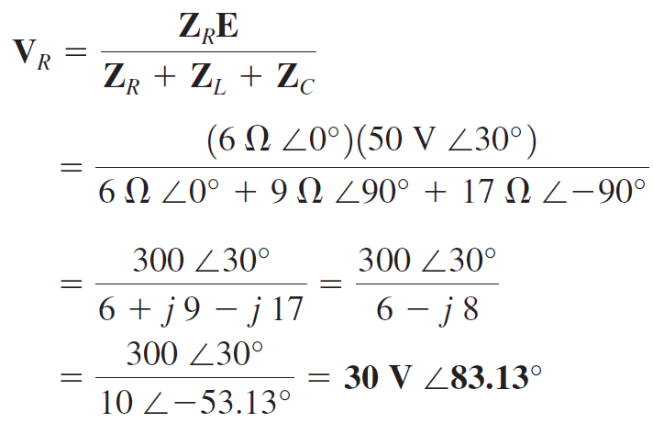
SERIES AC CIRCUITS
VOLTAGE DIVIDER RULE
EXAMPLE 2: Using the voltage divider rule, find the unknown voltages VR , VL , VC , and V1 for the circuit in Figure shown.
Solution:

Slide 39
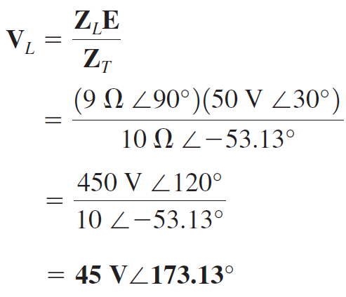
SERIES AC CIRCUITS
VOLTAGE DIVIDER RULE
EXAMPLE 2: Using the voltage divider rule, find the unknown voltages VR , VL , VC , and V1 for the circuit in Figure shown.
Solution:

Slide 40
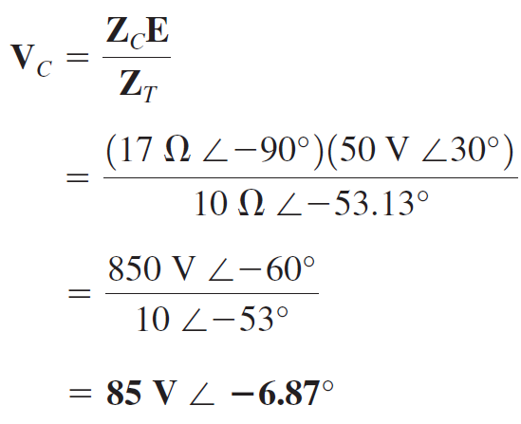
SERIES AC CIRCUITS
VOLTAGE DIVIDER RULE
EXAMPLE 2: Using the voltage divider rule, find the unknown voltages VR , VL , VC , and V1 for the circuit in Figure shown.
Solution:

Slide 41
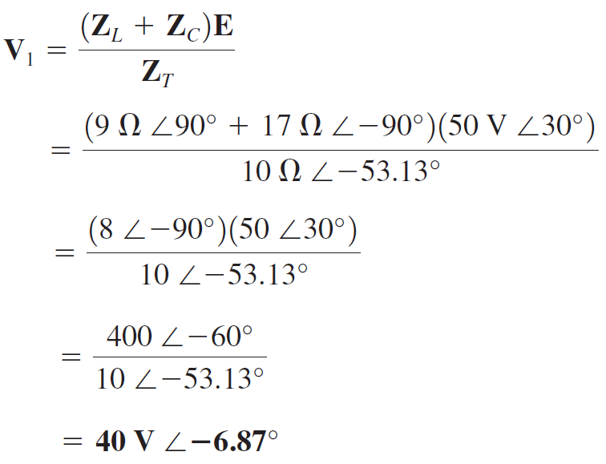
SERIES AC CIRCUITS
VOLTAGE DIVIDER RULE
EXAMPLE 2: Using the voltage divider rule, find the unknown voltages VR , VL , VC , and V1 for the circuit in Figure shown.
Solution:

Slide 42
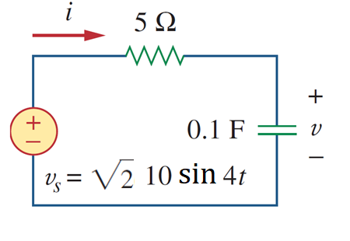
SERIES AC CIRCUITS
EXAMPLE 3: Find the voltage $v$ and current $i$ for the circuit in Figure shown.
Solution:
The voltage across the capacitor is

Slide 43
PARALLEL AC CIRCUITS
PARALLEL CONFIGURATION

Slide 44
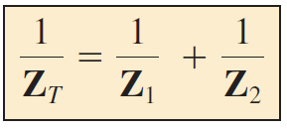
PARALLEL AC CIRCUITS
PARALLEL CONFIGURATION
For two impedances in parallel,

Slide 45
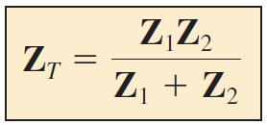
PARALLEL AC CIRCUITS
PARALLEL CONFIGURATION
For two impedances in parallel,

Slide 46
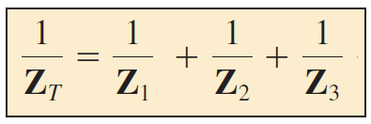
PARALLEL AC CIRCUITS
PARALLEL CONFIGURATION
For three impedances in parallel,

Slide 47
PARALLEL AC CIRCUITS
PARALLEL CONFIGURATION
The conductance (G) is the reciprocal of resistance, and

Slide 48
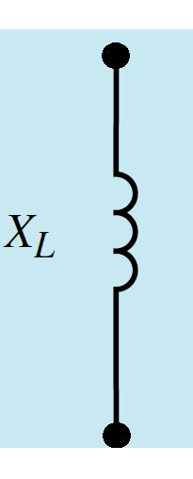
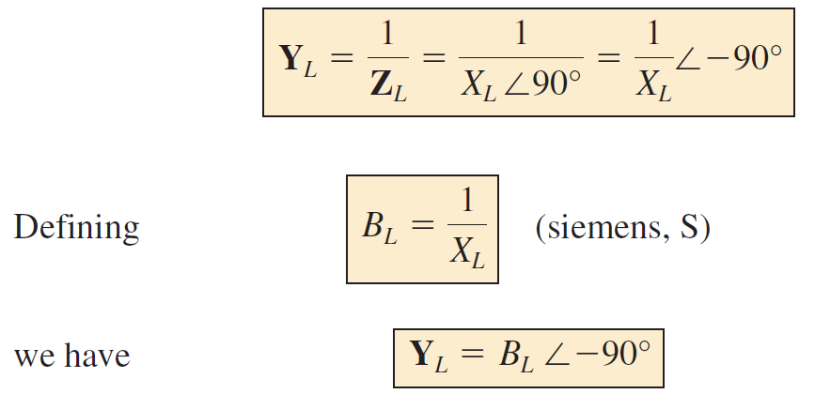
PARALLEL AC CIRCUITS
PARALLEL CONFIGURATION
The reciprocal of reactance (1/X) is called susceptance (B)
For the inductor,

Slide 49
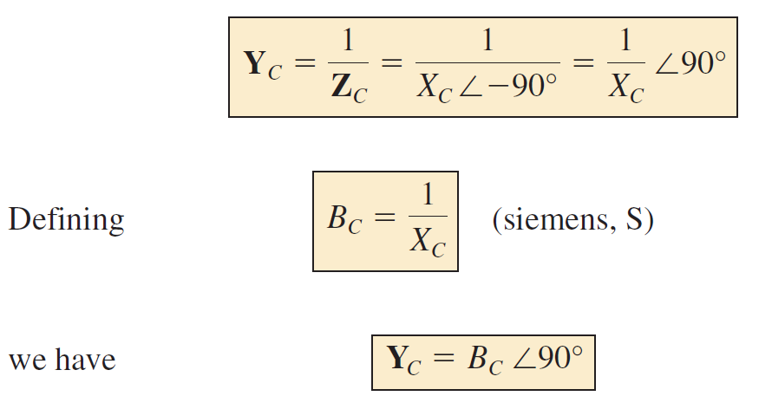
PARALLEL AC CIRCUITS
PARALLEL CONFIGURATION
The reciprocal of reactance (1/X) is called susceptance (B)
For the capacitor,

Slide 50
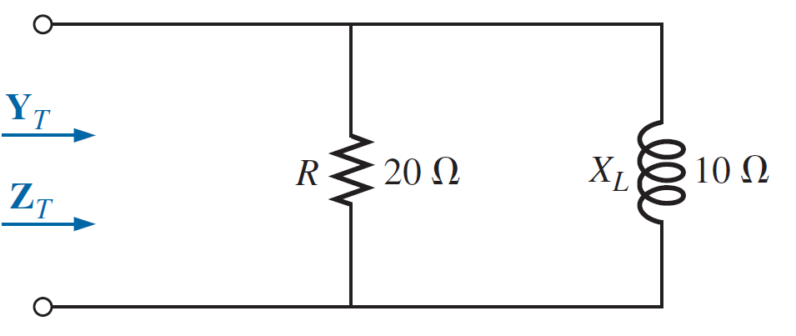
PARALLEL AC CIRCUITS
PARALLEL CONFIGURATION
EXAMPLE 4: For the circuit in Figure shown.
a. Calculate the input impedance.
b. Find the admittance of each parallel branch.
c. Determine the input admittance.

Slide 51
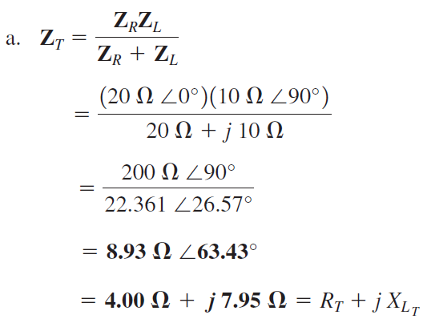
PARALLEL AC CIRCUITS
PARALLEL CONFIGURATION
EXAMPLE 4: For the circuit in Figure shown.
a. Calculate the input impedance.
b. Find the admittance of each parallel branch.
c. Determine the input admittance.
Solutions:

Slide 52
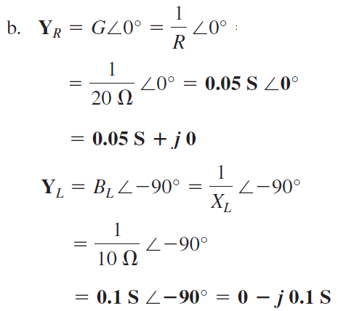
PARALLEL AC CIRCUITS
PARALLEL CONFIGURATION
EXAMPLE 4: For the circuit in Figure shown.
a. Calculate the input impedance.
b. Find the admittance of each parallel branch.
c. Determine the input admittance.
Solutions:

Slide 53
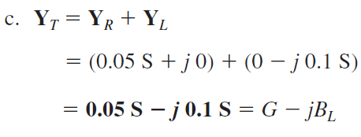
PARALLEL AC CIRCUITS
PARALLEL CONFIGURATION
EXAMPLE 4: For the circuit in Figure shown.
a. Calculate the input impedance.
b. Find the admittance of each parallel branch.
c. Determine the input admittance.
Solutions:

Slide 54
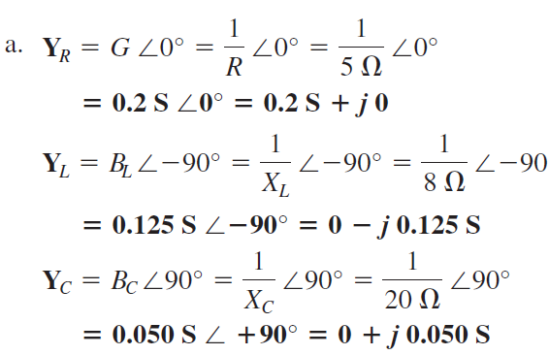
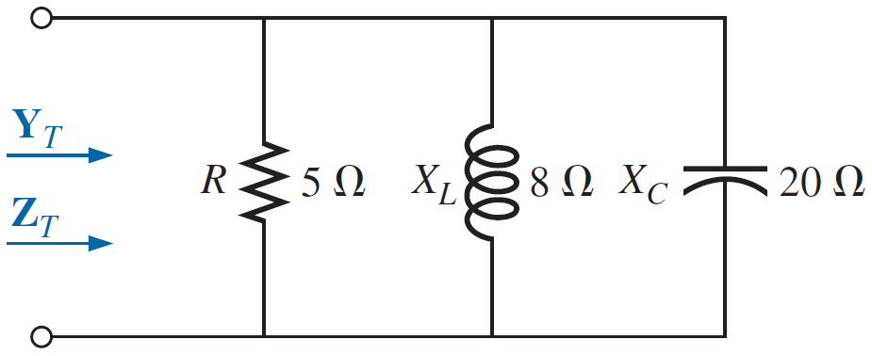
PARALLEL AC CIRCUITS
PARALLEL CONFIGURATION
EXAMPLE 5: For the circuit in Figure shown.
a. Find the admittance of each parallel branch.
b. Determine the input admittance.
c. Determine the input impedance.
Solutions:

Slide 55
PARALLEL AC CIRCUITS
PARALLEL CONFIGURATION
EXAMPLE 5: For the circuit in Figure shown.
a. Find the admittance of each parallel branch.
b. Determine the input admittance.
c. Determine the input impedance.
Solutions:

Slide 56
PARALLEL AC CIRCUITS
PARALLEL CONFIGURATION
EXAMPLE 5: For the circuit in Figure shown.
a. Find the admittance of each parallel branch.
b. Determine the input admittance.
c. Determine the input impedance.
Solutions:

Slide 57
PARALLEL AC CIRCUITS
PARALLEL CONFIGURATION
EXAMPLE 5: For the circuit in Figure shown.
a. Find the admittance of each parallel branch.
b. Determine the input admittance.
c. Determine the input impedance.
Solutions:

Slide 58
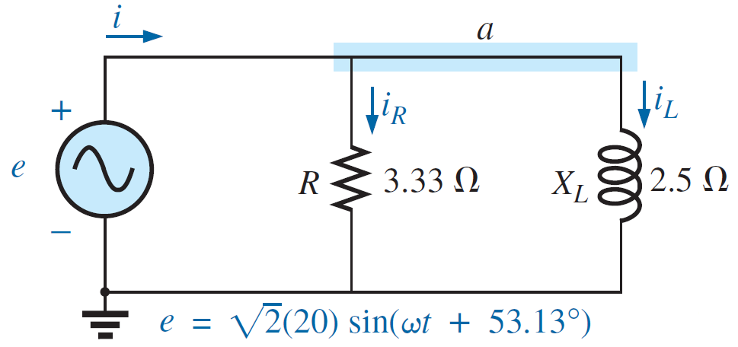
PARALLEL AC CIRCUITS
Parallel Examples
EXAMPLE 6: For the circuit in Figure shown.
a. Find the input admittance and impedance.
b. Determine the currents$, {I, I}_{R}, and I_{L}$.
c. Calculate the total power.
d. Determine the power factor.

Slide 59
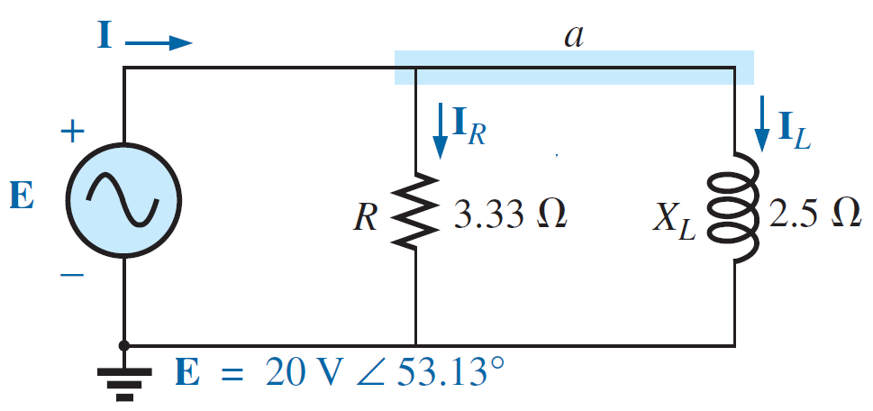
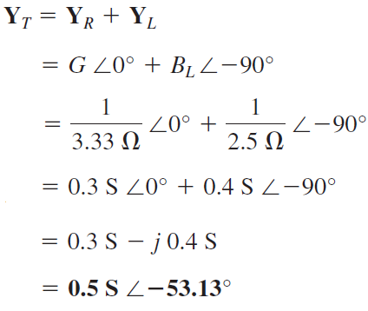
PARALLEL AC CIRCUITS
Parallel Examples
EXAMPLE 6: For the circuit in Figure shown.
a. Find the input admittance and impedance.
b. Determine the currents$, {I, I}_{R}, and I_{L}$.
c. Calculate the total power.
d. Determine the power factor.
Solutions:
a.

Slide 60
PARALLEL AC CIRCUITS
Parallel Examples
EXAMPLE 6: For the circuit in Figure shown.
a. Find the input admittance and impedance.
b. Determine the currents$, {I, I}_{R}, and I_{L}$.
c. Calculate the total power.
d. Determine the power factor.
Solutions:
a.

Slide 61
PARALLEL AC CIRCUITS
Parallel Examples
EXAMPLE 6: For the circuit in Figure shown.
a. Find the input admittance and impedance.
b. Determine the currents$, {I, I}_{R}, and I_{L}$.
c. Calculate the total power.
d. Determine the power factor.
Solutions:
b.

Slide 62
PARALLEL AC CIRCUITS
Parallel Examples
EXAMPLE 6: For the circuit in Figure shown.
a. Find the input admittance and impedance.
b. Determine the currents$, {I, I}_{R}, and I_{L}$.
c. Calculate the total power.
d. Determine the power factor.
Solutions:
b.

Slide 63
PARALLEL AC CIRCUITS
Parallel Examples
EXAMPLE 6: For the circuit in Figure shown.
a. Find the input admittance and impedance.
b. Determine the currents$, {I, I}_{R}, and I_{L}$.
c. Calculate the total power.
d. Determine the power factor.
Solutions:
b.

Slide 64
PARALLEL AC CIRCUITS
Parallel Examples
EXAMPLE 6: For the circuit in Figure shown.
a. Find the input admittance and impedance.
b. Determine the currents$, {I, I}_{R}, and I_{L}$.
c. Calculate the total power.
d. Determine the power factor.
Solutions:
b.

Slide 65
PARALLEL AC CIRCUITS
Parallel Examples
EXAMPLE 6: For the circuit in Figure shown.
a. Find the input admittance and impedance.
b. Determine the currents$, {I, I}_{R}, and I_{L}$.
c. Calculate the total power.
d. Determine the power factor.
Solutions:
c.

Slide 66
PARALLEL AC CIRCUITS
Parallel Examples
EXAMPLE 6: For the circuit in Figure shown.
a. Find the input admittance and impedance.
b. Determine the currents$, {I, I}_{R}, and I_{L}$.
c. Calculate the total power.
d. Determine the power factor.
Solutions:
d.
where G and Y_{T} are the magnitudes of the total conductance and admittance of the parallel network.

Slide 67
PARALLEL AC CIRCUITS
Parallel Examples
EXAMPLE 6: For the circuit in Figure shown.
a. Find the input admittance and impedance.
b. Determine the currents$, {I, I}_{R}, and I_{C}$.
c. Calculate the total power.
d. Determine the power factor.

Slide 68
PARALLEL AC CIRCUITS
Parallel Examples
EXAMPLE 6: For the circuit in Figure shown.
a. Find the input admittance and impedance.
b. Determine the currents$, {E, I}_{R}, and I_{C}$.
c. Calculate the total power.
d. Determine the power factor.
Solutions:
a.

Slide 69
PARALLEL AC CIRCUITS
Parallel Examples
EXAMPLE 6: For the circuit in Figure shown.
a. Find the input admittance and impedance.
b. Determine the currents$, {E, I}_{R}, and I_{C}$.
c. Calculate the total power.
d. Determine the power factor.
Solutions:
b.
Or

Slide 70
PARALLEL AC CIRCUITS
Parallel Examples
EXAMPLE 6: For the circuit in Figure shown.
a. Find the input admittance and impedance.
b. Determine the currents$, {E, I}_{R}, and I_{C}$.
c. Calculate the total power.
d. Determine the power factor.
Solutions:
b.

Slide 71
PARALLEL AC CIRCUITS
Parallel Examples
EXAMPLE 6: For the circuit in Figure shown.
a. Find the input admittance and impedance.
b. Determine the currents$, {E, I}_{R}, and I_{C}$.
c. Calculate the total power.
d. Determine the power factor.
Solutions:
c.
Or

Slide 72
PARALLEL AC CIRCUITS
Parallel Examples
EXAMPLE 6: For the circuit in Figure shown.
a. Find the input admittance and impedance.
b. Determine the currents$, {E, I}_{R}, and I_{C}$.
c. Calculate the total power.
d. Determine the power factor.
Solutions:
d.
Or

Slide 73
PARALLEL AC CIRCUITS
Parallel Examples
EXAMPLE 7: For the circuit in Figure shown.
a. Find the input admittance and impedance.
b. Determine the currents$, {I, I}_{R},, I_{L} and I_{C}$.
c. Calculate the total power.
d. Determine the power factor.
Solutions:
a.

Slide 74
PARALLEL AC CIRCUITS
Parallel Examples
EXAMPLE 7: For the circuit in Figure shown.
a. Find the input admittance and impedance.
b. Determine the currents$, {I, I}_{R},, I_{L} and I_{C}$.
c. Calculate the total power.
d. Determine the power factor.
Solutions:
a.

Slide 75
PARALLEL AC CIRCUITS
Parallel Examples
EXAMPLE 7: For the circuit in Figure shown.
a. Find the input admittance and impedance.
b. Determine the currents$, {I, I}_{R},, I_{L} and I_{C}$.
c. Calculate the total power.
d. Determine the power factor.
Solutions:
b.

Slide 76
PARALLEL AC CIRCUITS
Parallel Examples
EXAMPLE 7: For the circuit in Figure shown.
a. Find the input admittance and impedance.
b. Determine the currents$, {I, I}_{R},, I_{L} and I_{C}$.
c. Calculate the total power.
d. Determine the power factor.
Solutions:
c.
Or
Or

Slide 77
PARALLEL AC CIRCUITS
Parallel Examples
EXAMPLE 7: For the circuit in Figure shown.
a. Find the input admittance and impedance.
b. Determine the currents$, {I, I}_{R},, I_{L} and I_{C}$.
c. Calculate the total power.
d. Determine the power factor.
Solutions:
d.
Or

Slide 78
PARALLEL AC CIRCUITS
Current Divider Rule
The basic format for the current divider rule in ac circuits is exactly the same as that for dc circuits; that is, for two parallel branches with impedances Z1 and Z2 as shown in Figure,

Slide 79
PARALLEL AC CIRCUITS
Current Divider Rule
EXAMPLE 8: Using the current divider rule, find the current through each impedance in Figure.

Slide 80
PARALLEL AC CIRCUITS
Current Divider Rule
EXAMPLE 8: Using the current divider rule, find the current through each impedance in Figure.
Solutions:

Slide 81
References
Boylestad, Robert L. Introductory circuit analysis. Pearson Education, 2010.
Robbins, Allan H., and Wilhelm C. Miller. Circuit analysis: Theory and practice. Cengage Learning, 2012.
Sadiku, Matthew NO, and Chales K. Alexander. Fundamentals of electric circuits. McGraw-Hill Higher Education, 2007.

